Slide 1
Local Adaptation in Olympia Oysters:
HSP70 mRNA Expression Response to Mild Heat Stress

Slide 2
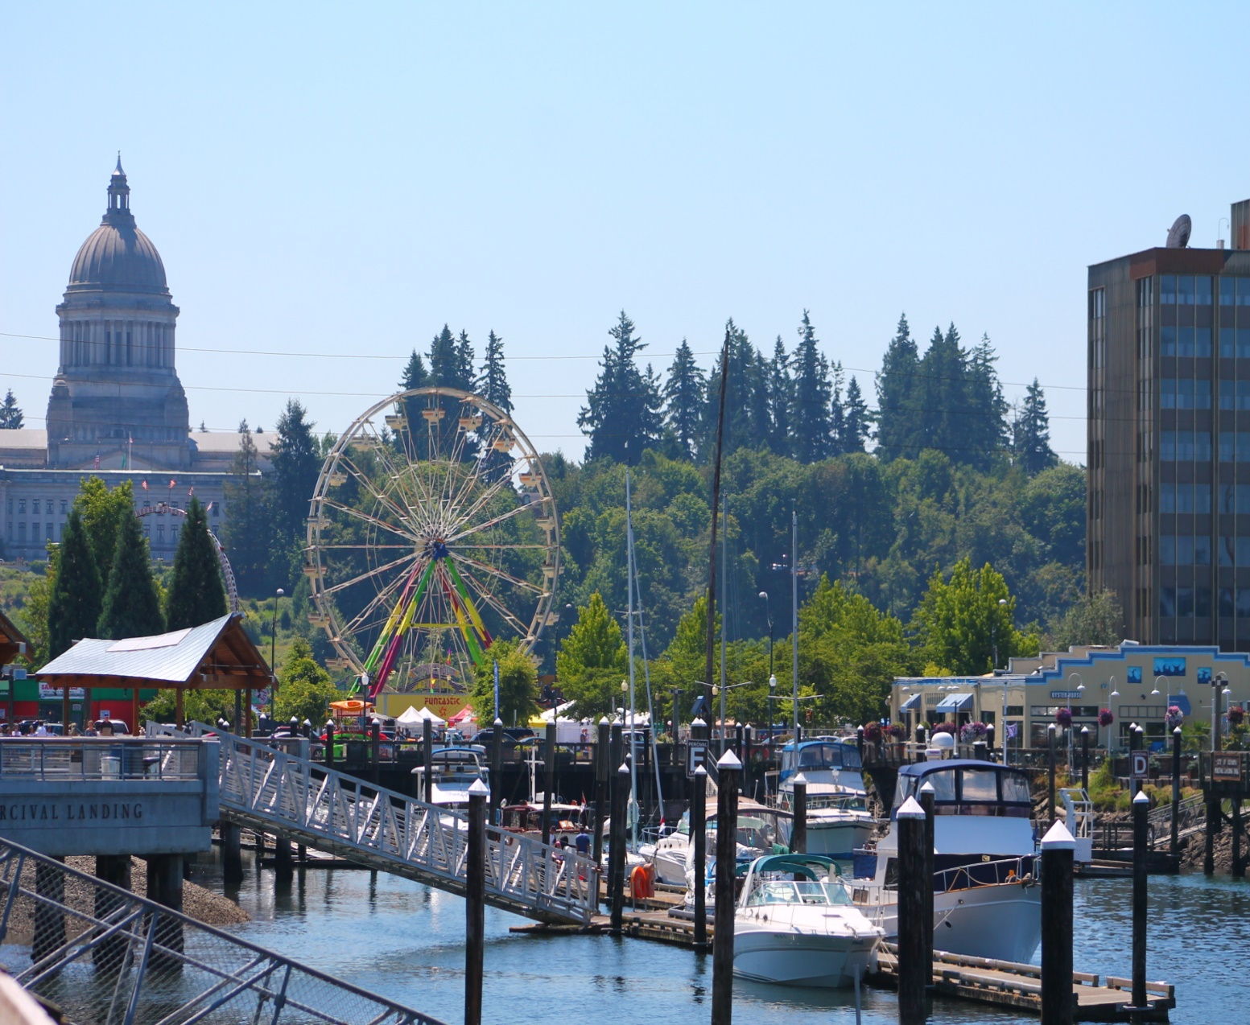
Olympia oysters in the Puget Sound
100 years of Anthropogenic Influence
Declines in most native species
Olympia oyster
  Historically Important
  Culturally Important
  Commercially Harvest
  Population Decline
Photo: thurstontalk.com

Slide 3
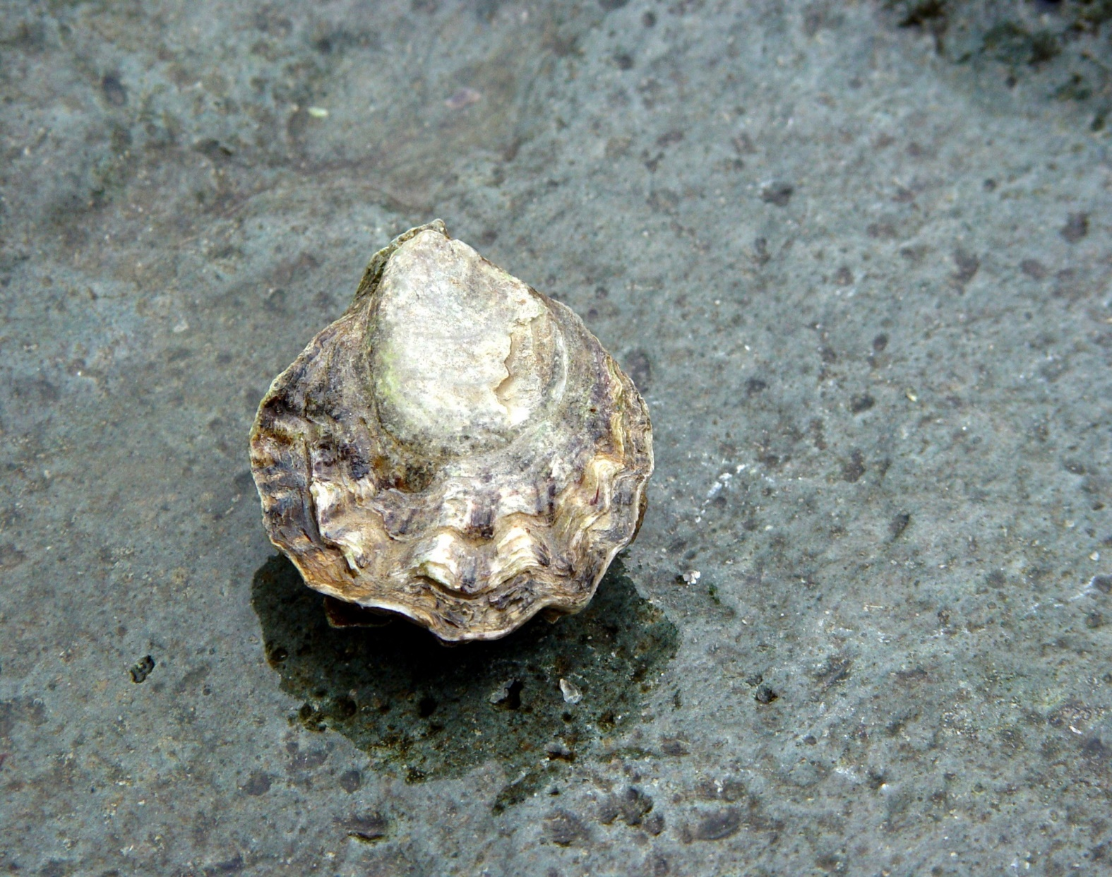
Life history of Olympia Oysters
Mexico to Alaska
Cold Water Adapted
Small Size
Salinity requirements
Threatened By
  Pollution
  Fresh Water Inundation
  Overharvest
  Ocean Acidification
  Climate Change
Photo: John Rowley/ Flickr

Slide 4
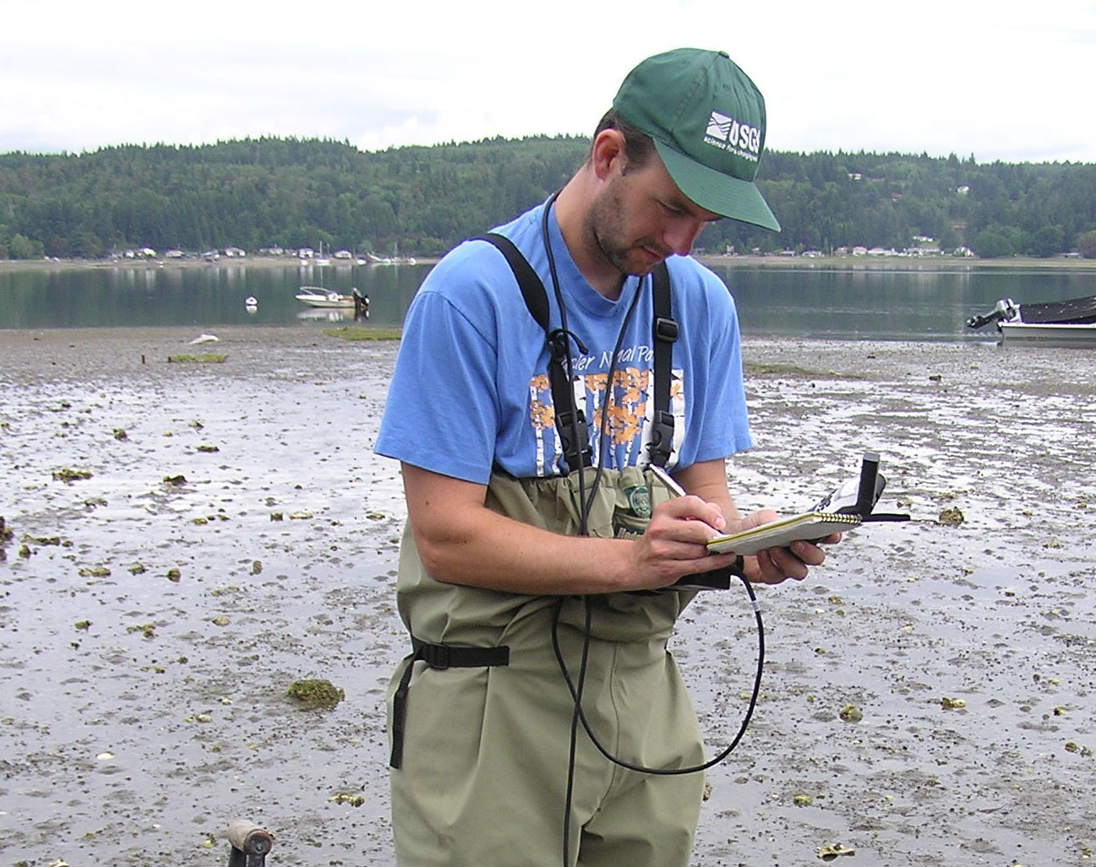
Rehabilitation Efforts
Extensive Rehabilitation Efforts
  Puget Sound Restoration Fund
  NOAA/NMFS
  Private Producers
Limited Success
  Poor Location Selection
  Poor outplanting timing
  High Predation
  Other?
Photo: Puget Sound Restoration Fund

Slide 5
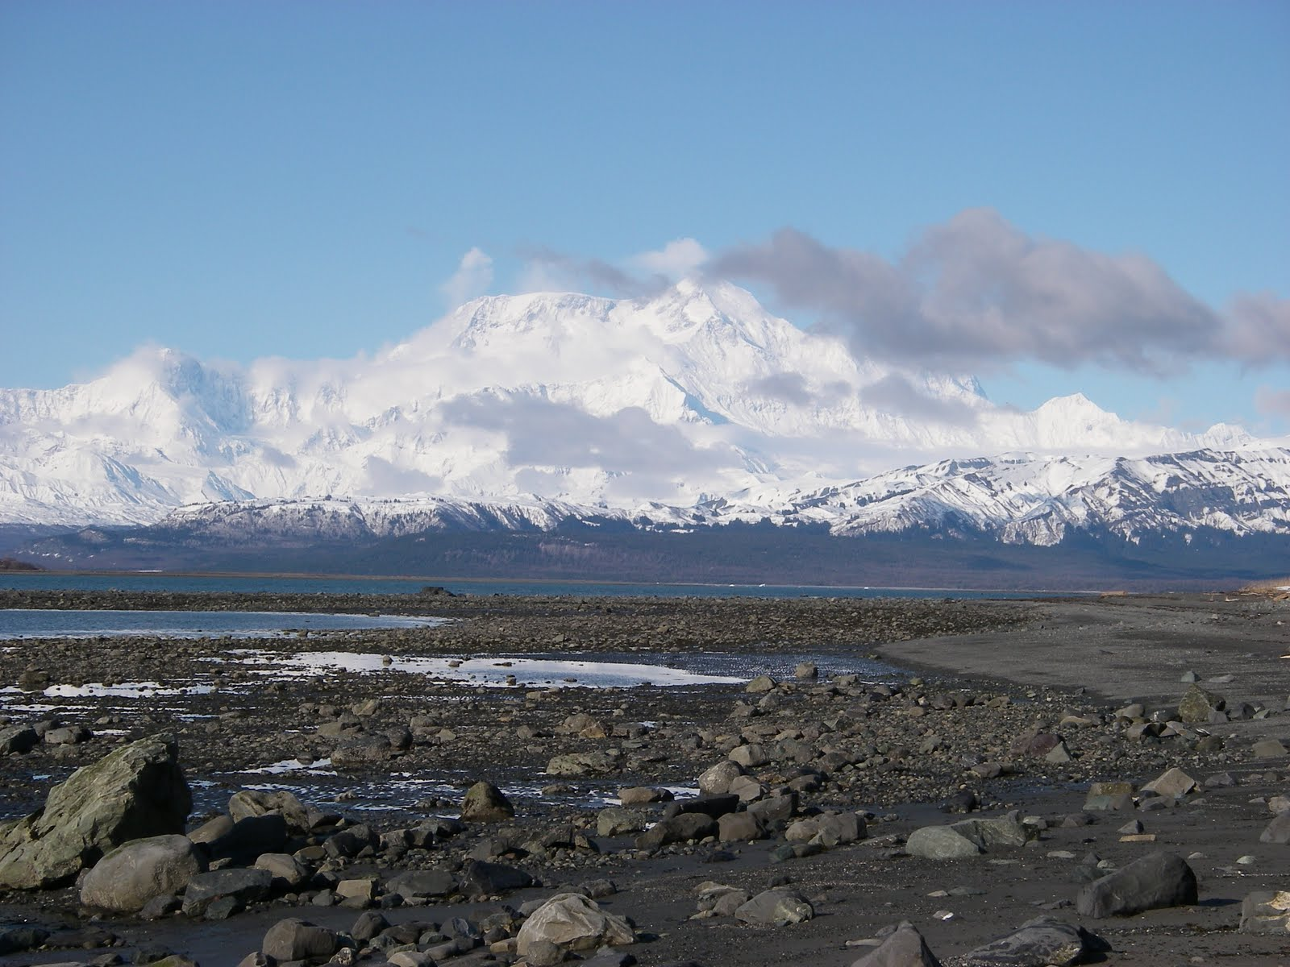
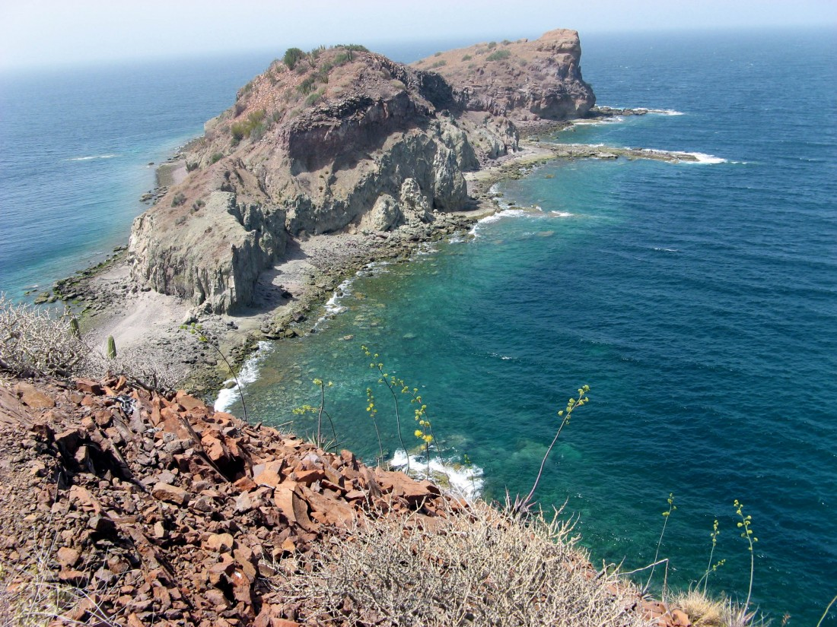
Local Adapation
Local adaptation is a phenomena in which geographically separated populations of a native species are better adapted to the habitat parameters of their specific location.(Kawecki and Ebert, 2004).
Photo: Baja Travel Tours
Photo: Alaskan Cruises

Slide 6
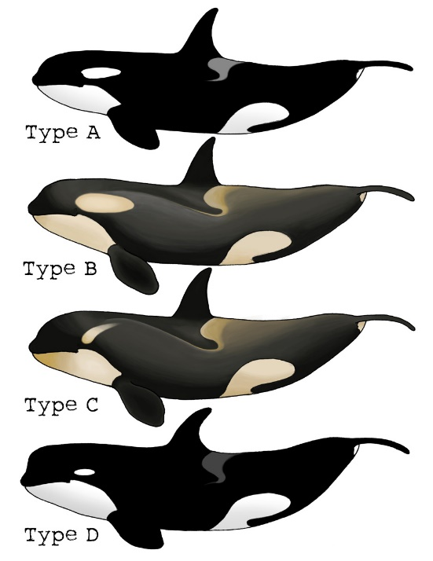
Local Adaptation Cont.
Differing Environment Conditions and Selection
  Temperature
  Salinity
  DO
  Etc.
Genetic and Phenotypic Differences
  Size, Shape, Color, Etc
  Growth/Development
  Response Mechanisms
Photo: retrieverman.net

Slide 7
Response Mechanisms
Many pathways effected
  Energy Metabolism
  Reproduction
  Homeostatic Regulatory Enzymes
Affected Regulatory Enzymes
  Copper Toxicity Response (Ritter et al., 2010)
  Phosphoglucose isomerase (Dahlhoff and Rank, 2000)
  HSP70 (Feder and Hofmann, 1999)
Effects
  Downregulation
  Isoform Concentrations
  Priming

Slide 8
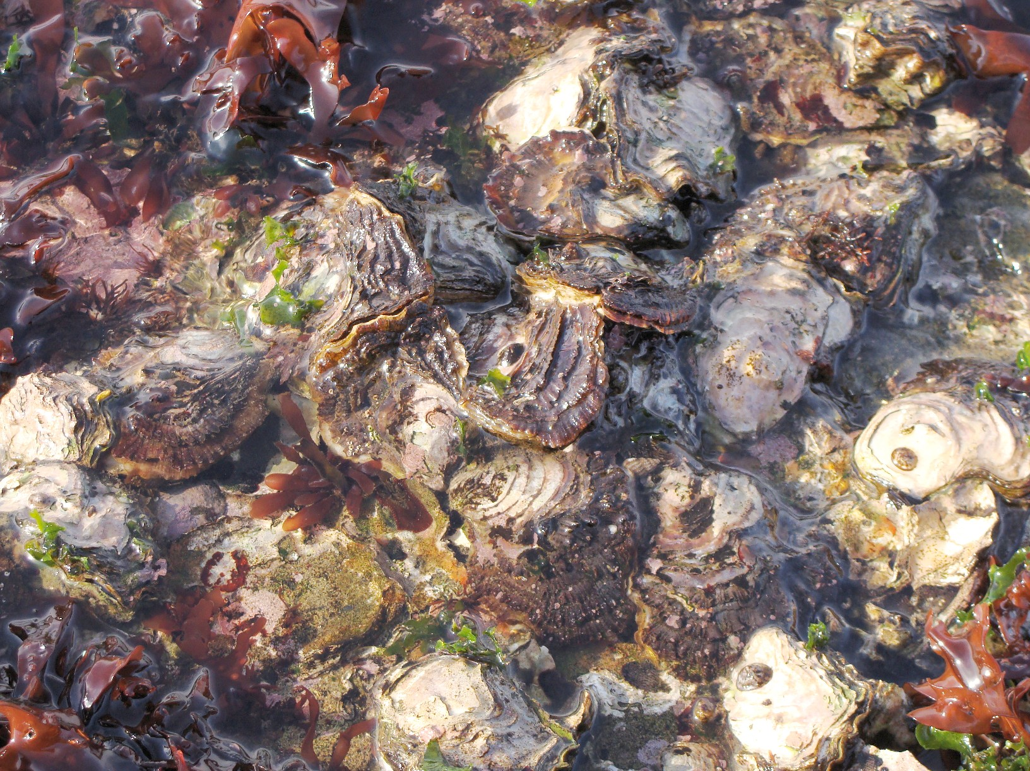
HSP70
Maintain Protein Function
Biomarker for Stress
Affected by Local Adaptation
Well Studied
Photo: Matt DiLeo/thescientistgardner blog

Slide 9
Hypothesis
Populations from warmer southern regions will be better adapted to handle heat stress than those from colder northern regions.
Does HSP70 response vary between populations during mild heat stress events?
Can we measure this response through mRNA concentrations for HSP70 transcripts?

Slide 10
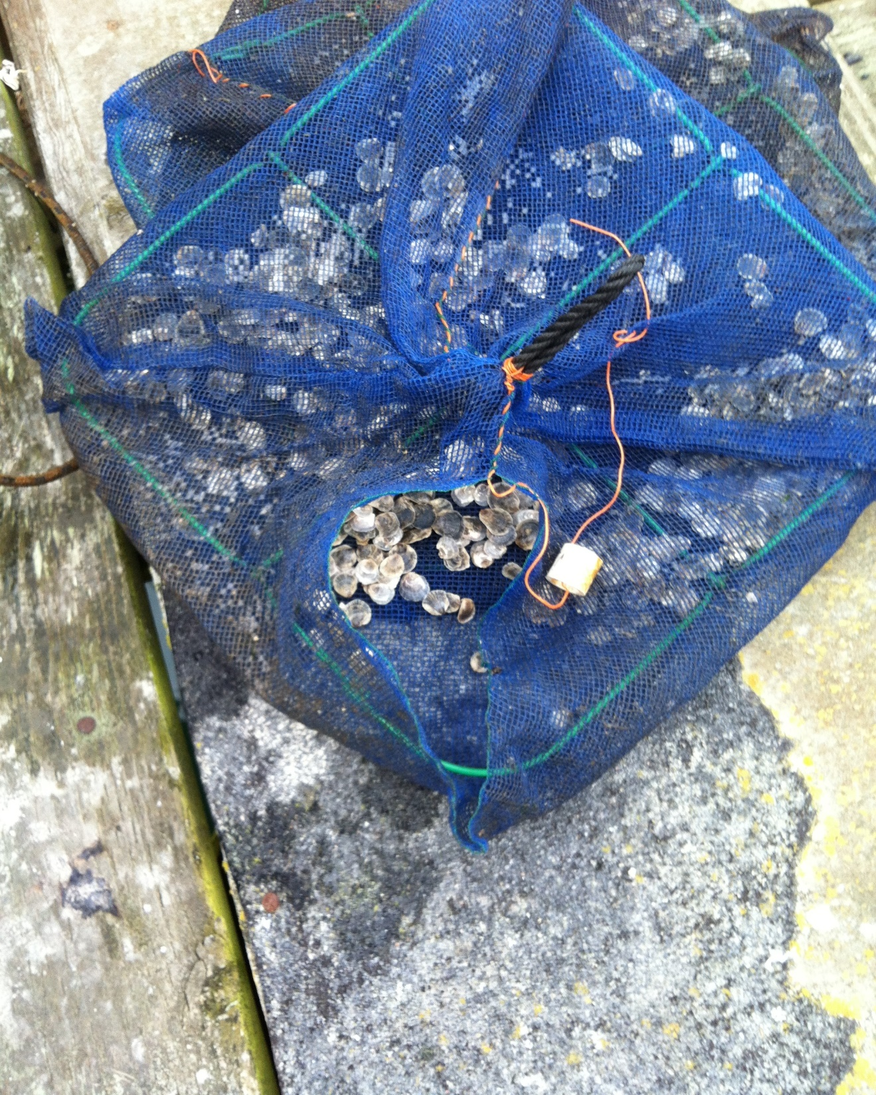
Experiment
Oysters
  Offspring from 3 distinct populations
  Collected in Port Gamble, WA
Set up
  1 tank
  Cold Room at 12 C
  Acclimated 1 week
  Fed once every 24 hours
Experiment
  Time 0 (12 C)
  Time 24 (24 C)
  Fed once
Sampling
  Measured Length
  Dissected out 50-250 ug whole body tissue
  Flash Frozen
  Stored in TriReagent
Photo: Christine Savolainen

Slide 11
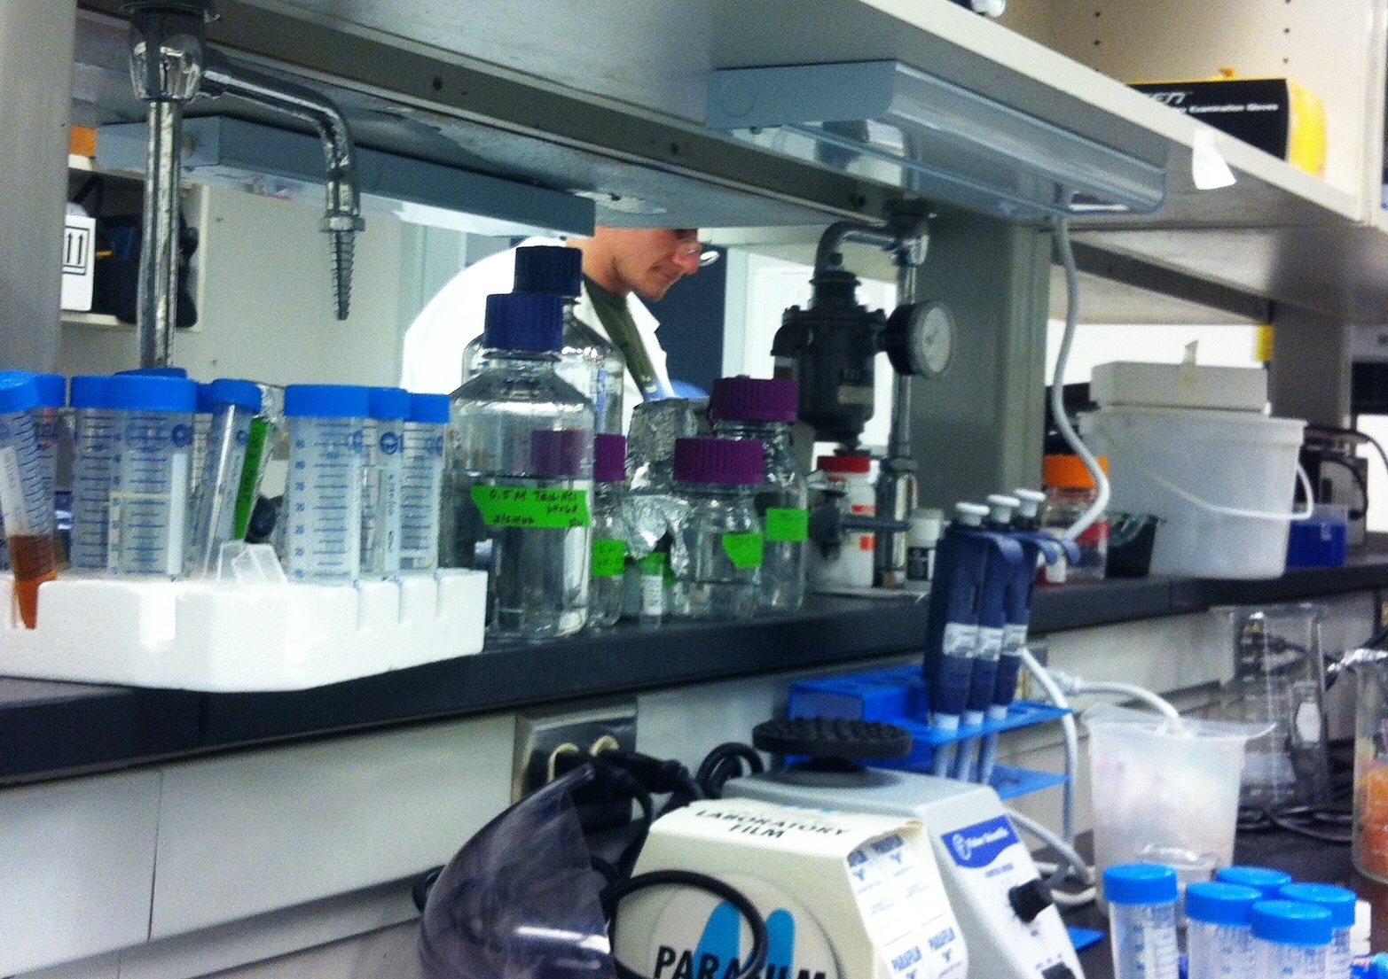
Processing/Testing
Phenol/Chloroform RNA isolation
cDNA created
Primers Designed
  HSP70 (C. gigas)
  Actin (O. lurida, Normalizing)
PCR
qPCR
Photo: Christine Savolainen

Slide 12
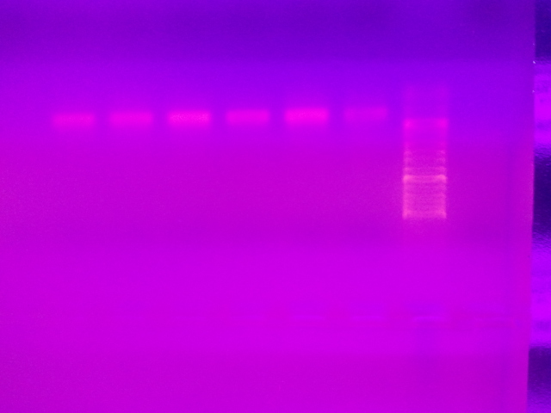
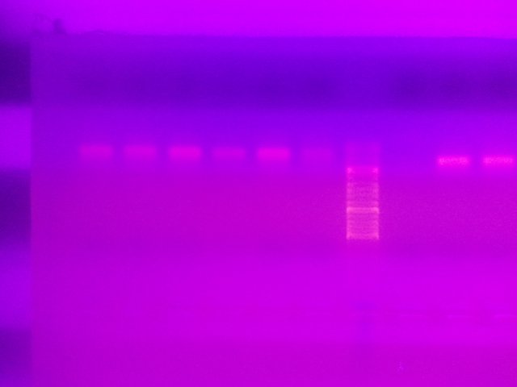
Results—PCR
Products in Agarose Gels
Strong Banding
Low Base pair sizes
~100 bp Actin
~200 HSP70
113 bp expect for Actin
208 BP expected for HSP70

Slide 13
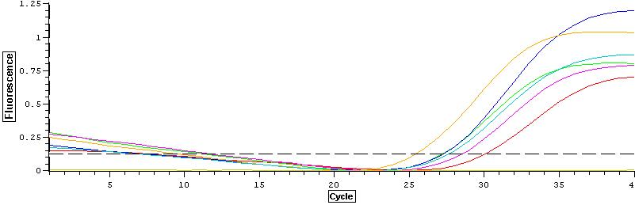
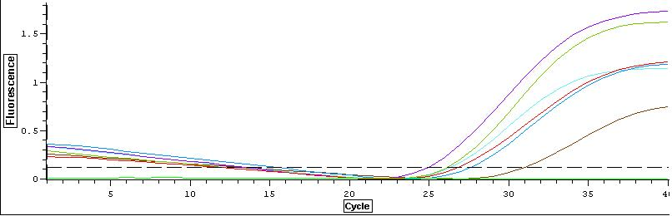
Results—qPCR Amplification Curve
HSP70
Actin

Slide 14
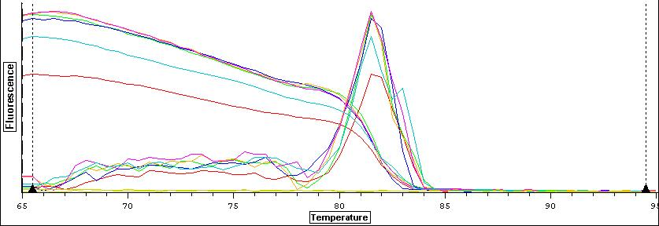
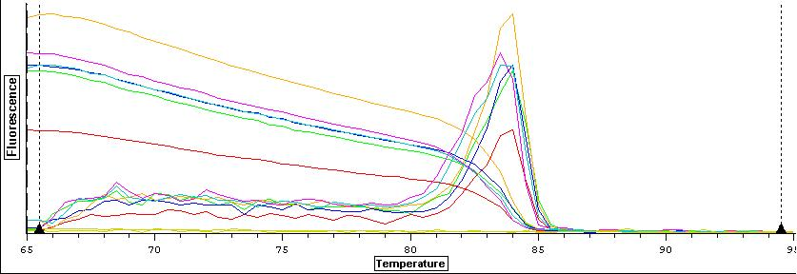
Results—qPCR Melt Curve
HSP70
Actin

Slide 15
Results—qPCR Data Table

Slide 16
Results—qPCR C(t) Normalized Values
Fluorescence Measured In Samples
No Fluorescence from Control
C(t) between 26-30
Later than expected
C(t) converted and normalized
=10^(-(0.3012*Ct)+11.434)
Normalized =V(h)/V(a)

Slide 17

Discussion
PCR results good
  Bands approximately the same size as expected
  No indiscriminate binding
qPCR results mirror PCR
  Amplification later than expected
  Normalized values show equality between Actin and HSP70 concentrations
  Slight differences between individuals not statistically significant
  Needs more replicates
Photo: Charlie Day/Pacific Rim/ Legendary Pictures

Slide 18
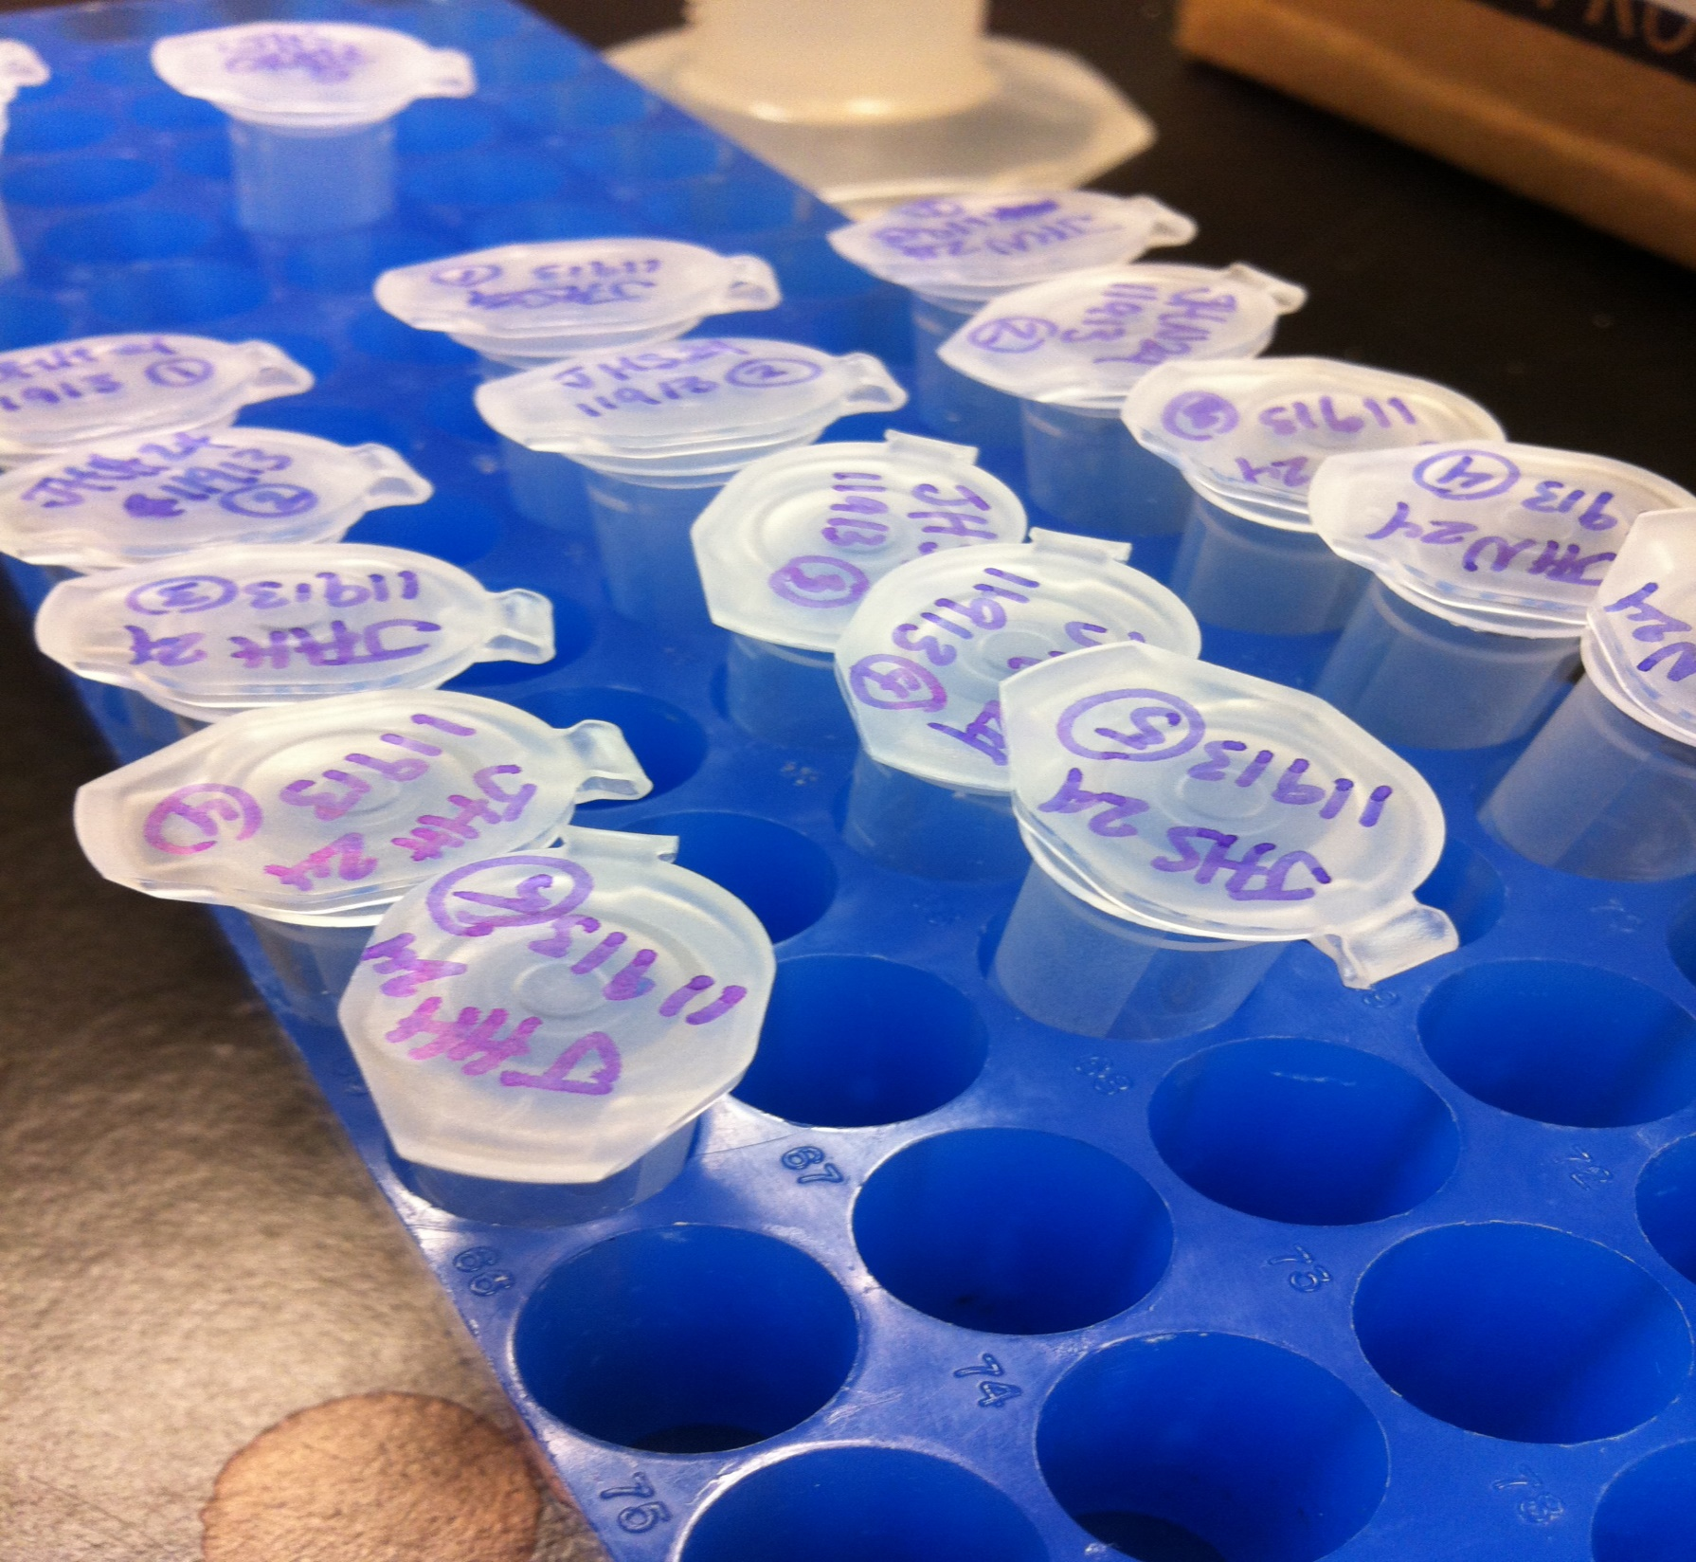
Conclusion
More replicates
More Time Points
Varied primers
Photo: Christine Savolainen

Slide 19
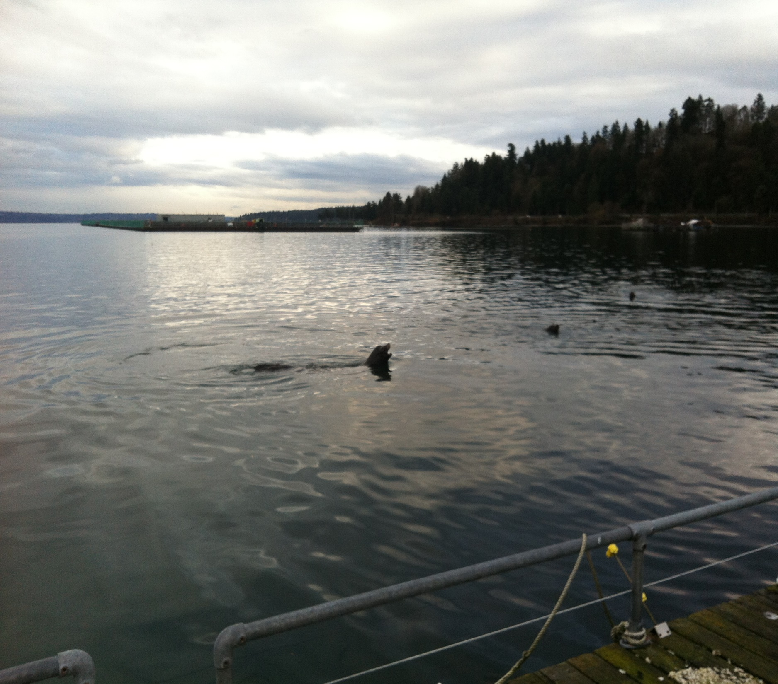
Thanks
Steven Roberts
Claire Olson
Mackenzie Gavery
Sam White
Ryan Crim PSRF
Christine Savolainen
And Viewers Like You!
Photo: Christine Savolainen

